Slide 1











Official (Closed) - Non Sensitive
Programming
Fundamentals
OBJECTS & LIBS
DIPLOMA IN FULL-STACK DEVELOPMENT
Certificate in Computing Fundamentals

Slide 2
Official (Closed) - Non Sensitive
More on Objects

Slide 3
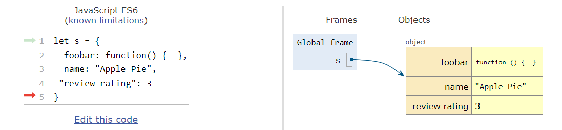

Official (Closed) - Non Sensitive
Objects are References
This means that:
They are passed by reference
They are not copied when assigned to another variable
Continuing Education & Training (CET)

Slide 4
Official (Closed) - Non Sensitive
Traversing Objects (1)
Using for (let <key> in <object>) allows us to retrieve each key from an object:
let book = {
"title": "The Lord of the Rings",
"author": "JRR Tolkien",
"ISBN":"123-123-123-123",
"pages": 7220
}
for (let k in book) {
console.log(k);
}
title
author
ISBN
pages
Continuing Education & Training (CET)

Slide 5
Official (Closed) - Non Sensitive
Traversing Objects (2)
We can therefore use the extracted key with the [ ] operator to get each value:
let book = {
"title": "The Lord of the Rings",
"author": "JRR Tolkien",
"ISBN":"123-123-123-123",
"pages": 7220
}
for (let k in book) {
console.log(book[k]);
}
The Lord of the Rings
JRR Tolkien
123-123-123-123
7220
Continuing Education & Training (CET)

Slide 6
Official (Closed) - Non Sensitive
Nested Objects
The value of a property can also be an object:
let employee = {
firstName:'Tan',
lastName:'Ah Kow',
address: {
street:'Yishun Ring Road',
building:'Blk 636',
unit:'#13-221'
}
}
console.log(employee.address.street);
Yishun Ring Road
Continuing Education & Training (CET)

Slide 7
Official (Closed) - Non Sensitive
Object Methods
Continuing Education & Training (CET)

Slide 8
Official (Closed) - Non Sensitive
Object.values()
Return the values of all properties as an array. Usage:
[ 'The Lord of the Rings', 'JRR Tolkien', '123-123-123-123', 7220 ];
let book = {
"title": "The Lord of the Rings",
"author": "JRR Tolkien",
"ISBN":"123-123-123-123",
"pages": 7220
}
console.log("Object.values(book) =>", Object.values(book));
Continuing Education & Training (CET)

Slide 9
Official (Closed) - Non Sensitive
Object Methods
There are a number of methods that you can use on an object. We'll go through the most common of those methods.
Continuing Education & Training (CET)

Slide 10
Official (Closed) - Non Sensitive
Object.entries()
Returns the key/value of one property at a time. Use in a for loop:
Usage:
for (let [key, value] of Object.entries(book)) {
console.log(key,"=>",value)
}
Output:
title => The Lord of the Rings
author => JRR Tolkien
ISBN => 123-123-123-123
pages => 7220
Continuing Education & Training (CET)

Slide 11
Official (Closed) - Non Sensitive
Object.hasOwnProperty()
Check if a property name exists in the Object:
console.log("book.hasOwnProperty() =>",book.hasOwnProperty('pages'));
// Or doing almost the same thing:
console.log('"pages in book =>"', "pages" in book);
Continuing Education & Training (CET)

Slide 12
Official (Closed) - Non Sensitive
Object.assign()
"Merges" the properties of two objects together into a new object. The second priorities from the second object has higher priority.
let book = {
"title": "The Lord of the Rings",
"author": "JRR Tolkien",
"ISBN":"123-123-123-123",
"pages": 7220
}
let changes = {
'pages': 900
}
let book2 = Object.assign(book, changes);
console.log(book2);
{
title: 'The Lord of the Rings',
author: 'JRR Tolkien',
ISBN: '123-123-123-123',
pages: 900
}
Continuing Education & Training (CET)

Slide 13
Official (Closed) - Non Sensitive
Destructuring Objects
Continuing Education & Training (CET)

Slide 14
Official (Closed) - Non Sensitive
Destructuring Objects
You can copy the values of properties in an object into new variables using destructuring.
let fruits = {
"apples": 20,
"bananas": 35,
"pears": 45,
"oranges": 66
}
let {bananas, pears} = fruits;
console.log(bananas, pears);
// will get 35, 45
The variable names must match the property names that we will to copy to the variable
Continuing Education & Training (CET)

Slide 15
Official (Closed) - Non Sensitive
Destructuring & Rename
You can rename the copied variables if you like:
let fruits = {
"apples": 20,
"bananas": 35,
"pears": 45,
"oranges": 66
}
let {bananas:b, pears:p} = fruits;
console.log(b, p);
// will still get 35, 45
Continuing Education & Training (CET)

Slide 16
Official (Closed) - Non Sensitive
Destructuring an object as Params
You can destruct an object as parameters in a function too!
let product = {
'price': 35,
'sku': 'APPLE01',
'description':'Red apples',
'salesTax': 0.07
}
function calculateTotalPrice({price, salesTax}) {
return price * salesTax; }
console.log(calculateTotalPrice(product));
Continuing Education & Training (CET)

Slide 17
Official (Closed) - Non Sensitive
The 5 HTTP methods
Recap for API
Continuing Education & Training (CET)

Slide 18
Official (Closed) - Non Sensitive
The “Verbs”
There are five kind of actions we can perform when making a HTTP request. Those are known as verbs or methods
GET → retrieve data
PUT or PATCH → update data
POST → Create new data on the server
DELETE → Delete new data from the server
Continuing Education & Training (CET)

Slide 19
Official (Closed) - Non Sensitive
HTTP Get & Params
Continuing Education & Training (CET)

Slide 20
Official (Closed) - Non Sensitive
Endpoint is Dynamic
Unlike a json file, the output of a RESTFul API endpoint is generated by a program.
So there's a program running behind each point. When we consume an endpoint, it's like calling a function over the Internet.
Continuing Education & Training (CET)

Slide 21
Official (Closed) - Non Sensitive
Parameters
Those are the "arguments" we pass to the endpoint.
The endpoint will act differently base on the arguments
Continuing Education & Training (CET)

Slide 22
Official (Closed) - Non Sensitive
Endpoint & Query String
The query string are the parameters passed to the end point.
It's not part of the end point URL itself.
endpoint
Query string
https://iamasuperhero-api.herokuapp.com/reports?category=Powers%20On%20Empty
GET Method
Category = Powers On Empty
%20 is our spacebar
Continuing Education & Training (CET)

Slide 23
Understanding Query Strings
The ? is the start of the query string.
Each parameter is separated by a &
Each pair of = is one parameter
?category=food&search_terms=chicken
The search_terms parameter has the value of chicken
The category parameter has the value of food

Slide 24
Official (Closed) - Non Sensitive
Understanding Query Strings
https://www.food.fake/search?category=food&search_terms=chicken
Can be sent using axios as:
axios.get('https://www.food.fake/food, {
params: {
category:'food', search_terms:'chicken'
}
}
Continuing Education & Training (CET)

Slide 25
Official (Closed) - Non Sensitive
HTTP Post & Body
Continuing Education & Training (CET)

Slide 26
Official (Closed) - Non Sensitive
POST method
The HTTP POST method is used for creating new resources on the server.
For example, say we can create a new food by sending a request using the POST method to http://ww.food.fake/food and specify the body to have category and title.
Can be sent using axios as:
axios.post('https://www.food.fake/food, {
category:'food', title:'Chicken Rice'
}
}
Continuing Education & Training (CET)

Slide 27
Official (Closed) - Non Sensitive
HTTP Patch/Put
Continuing Education & Training (CET)

Slide 28
Official (Closed) - Non Sensitive
PUT method
Those two methods are used to update existing data.
Patch → update a resource by changing certain parts of the existing data
Put → update a resource by totally replacing it with new data
Continuing Education & Training (CET)

Slide 29
Official (Closed) - Non Sensitive
PUT method
For example, say we can create a update the chicken rice by sending a request using the PATCH method to http://ww.food.fake/food and specify the body to have category and title.
Can be sent using axios as:
axios.patch('https://www.food.fake/food/412, {
category:'chinese-food', title:'Hainanese Chicken Rice'
}
)
ID of the 'Chicken Rice' dish that we want to change
Continuing Education & Training (CET)

Slide 30
Official (Closed) - Non Sensitive
HTTP Delete
Continuing Education & Training (CET)

Slide 31
Official (Closed) - Non Sensitive
DELETE method
As its name implies, the DELETE method is for removing resources from the server.
For example, say we can create a delete the chicken rice with the id of 412 by sending a request using the DELETE method to http://ww.food.fake/food
Can be sent using axios as:
axios.delete('https://www.food.fake/food/412')
Continuing Education & Training (CET)

Slide 32
Official (Closed) - Non Sensitive
AXIOS
Delightful Library
Continuing Education & Training (CET)

Slide 33
Official (Closed) - Non Sensitive
Reading in JSON files
We can use the fetch api to retrieve JSON files
fruits.json
{
"fruits":[
"apples",
"oranges",
"bananas",
"blueberries"
]
}
fetch('data.json').then((r)=>{
return r.json()
}).then(function(json){
console.log(json);
})
data.json must be in the same directory as the JS file.
https://replit.com/@immalcolm/simple-axios
https://github.com/axios/axios
Continuing Education & Training (CET)

Slide 34
Official (Closed) - Non Sensitive
Using Axios
Axios is a library to manage fetch calls.
axios.get is async, will return a promise. A promise is a function that happens in the background
axios.get('data.json').then((r)=>{
return r.json()
}).then(function(json){
console.log(json);
})
This function is a called when the promise resolves
https://replit.com/@immalcolm/simple-axios
https://github.com/axios/axios
Continuing Education & Training (CET)

Slide 35
Official (Closed) - Non Sensitive
axios.get("data.json")
Main program resumes
axios.get() finishes, promise is executed
Promise finishes
Background loading of the JSON file
https://replit.com/@immalcolm/simple-axios
https://github.com/axios/axios
Continuing Education & Training (CET)

Slide 36
Official (Closed) - Non Sensitive
How does AXIOS work
Axios reads file using the HTTP protocol.
This is the same method the browser fetches HTML, CSS, image and such files from a web server.
The files must be available on a web server.
https://replit.com/@immalcolm/simple-axios
https://github.com/axios/axios
Continuing Education & Training (CET)

Slide 37
Official (Closed) - Non Sensitive
ASYNC/AWAIT
This is the most modern method of executing an asynchronous function.
async function getData() { let response = await axios.get('data.json'); console.log(response.data);
}
getData(); // execute the async function call
https://replit.com/@immalcolm/simple-axios
https://github.com/axios/axios
Continuing Education & Training (CET)

Slide 38
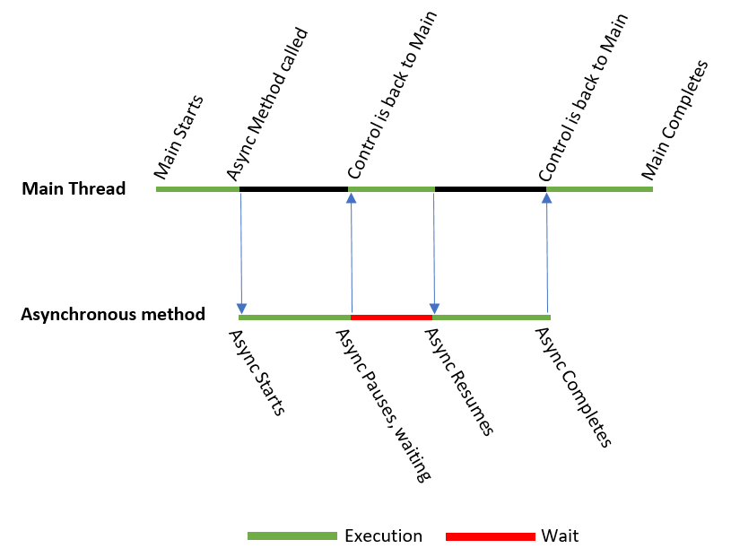
Official (Closed) - Non Sensitive
https://replit.com/@immalcolm/simple-axios
https://github.com/axios/axios
Continuing Education & Training (CET)

Slide 39
Official (Closed) - Non Sensitive
ASYNC/AWAIT
Await and async can only be used in functions marked with async
async function getData() { let response = await axios.get('data.json'); console.log(response.data);
}
getData(); // execute the async function call
https://replit.com/@immalcolm/simple-axios
https://github.com/axios/axios
Continuing Education & Training (CET)

Slide 40
Parallel Async/Await
Official (Closed) - Non Sensitive
<!DOCTYPE html>
<html>
<head>
<meta charset="utf-8">
<meta name="viewport" content="width=device-width">
<title>repl.it</title>
<link href="style.css" rel="stylesheet" type="text/css" />
</head>
<body>
<button id="load">Load</button>
<textarea id="output" rows="5"></textarea>
<script src="https://cdnjs.cloudflare.com/ajax/libs/axios/0.20.0/axios.min.js"></script>
<script src="script.js"></script>
</body>
</html>
document.querySelector("#load").addEventListener('click',
async function(){
let loader1 = axios.get('data.json');
let loader2 = axios.get('data1.json');
let loader3 = axios.get('data2.json');
let response = await loader1;
document.querySelector('#output').innerHTML += response.data.message + "\n";
response = await loader2;
document.querySelector('#output').innerHTML += response.data.message + "\n";
response = await loader3;
document.querySelector("#output").innerHTML += response.data.message +"\n";
})
Launch three axios requests without waiting for the previous one to end
https://replit.com/@immalcolm/simple-axios
https://github.com/axios/axios
Continuing Education & Training (CET)

Slide 41
Case 1: Complete in Order
Official (Closed) - Non Sensitive
await loader1
await loader2
await loader3
No need to wait since loader3 is already done
getData()
getData() will wait till loader2 is done.
Loader 1
fin
Loader 2
fin
Loader 3
fin
loader3 is already completed at this point.
https://replit.com/@immalcolm/simple-axios
https://github.com/axios/axios
Continuing Education & Training (CET)

Slide 42
Case 2: Reverse Order
Official (Closed) - Non Sensitive
No need to wait since loader2 and loader3 are already ready
Waiting for loader1 to finish
await loader1
await loader2
await loader3
getData()
Loader 1
fin
Loader 2
fin
Loader 3
fin
All the other loading are happening in background
Continuing Education & Training (CET)

Slide 43
Case 3: What if it's synchronous?
Official (Closed) - Non Sensitive
axios.get('data.json')
axios.get('data1.json')
axios.get('data2.json')
document.querySelector("#load").addEventListener('click',
async function(){
let loader1 = axios.get('data.json');
let response = await loader1;
document.querySelector('#output').innerHTML += response.data.message + "\n";
let loader2 = axios.get('data1.json');
response = await loader2;
document.querySelector('#output').innerHTML += response.data.message + "\n";
let loader3 = axios.get('data2.json');
response = await loader3;
document.querySelector("#output").innerHTML += response.data.message +"\n";
})
await loader1
await loader2
await loader3
getData()
Loader 1
fin
Loader 2
fin
Loader 3
fin
Continuing Education & Training (CET)

Slide 44
Case 4: Best Case Scenario (async)
Official (Closed) - Non Sensitive
axios.get('data.json')
axios.get('data1.json')
axios.get('data2.json')
await loader2
getData()
await loader3
await loader1
Loader 1
fin
Loader 2
fin
Loader 3
fin
Continuing Education & Training (CET)

Slide 45
Official (Closed) - Non Sensitive
JSON FILE
[
{
"type": "digital",
"display_name": "Digital"
},
{
"type": "physical",
"display_name": "Physical"
},
{
"type": "service",
"display_name": "Online service"
}
]
[
{
"type": "cash",
"display_name":"Cash"
},
{
"type":"credit_card",
"display_name":"Credit Card"
},
{
"type": "paypal",
"display_name": "PayPal"
}
]
product-types.json
payment-types.json
Continuing Education & Training (CET)

Slide 46
Official (Closed) - Non Sensitive
Load all the product types from the JSON file
Data-Driven Form
<div>
<div>
<label>Product Name</label>
<input type="text" id="product-name" />
</div>
...
<script src="https://cdn.jsdelivr.net/npm/axios/dist/axios.min.js"></script>
<script src="list-driven-form.js"></script>
</body>
async function loadProductTypes() {
let response = await axios.get("product-types.json");
let productTypes = response.data;
let productTypeDiv = document.querySelector("#product_types");
for (let p of productTypes) {
let spanElement = document.createElement("span");
spanElement.innerHTML = `<input type="radio"
name="product-type"
class="product-type"
value="${p.type}"/>
<span>${p.display_name}</span>`;
productTypeDiv.appendChild(spanElement);
}
}
loadProductTypes();
Make sure to remember to include the axios script.
See the full code here: https://replit.com/@immalcolm/axios-data-driven
Continuing Education & Training (CET)

Slide 47
TOOLS OF THE TRADE
Official (Closed) - Non Sensitive
WORK SMART
Continuing Education & Training (CET)

Slide 48
Official (Closed) - Non Sensitive
Designs & Visuals (Where to start)
Use these sites to help you in you visual research
Dribbble - Get inspired by designers
https://dribbble.com/shots/popular/web-design
Behance.net “Linkedin” for creatives
https://www.behance.net/search/projects?field=web%20design
Find inspirations by design patterns
https://pttrns.com/
Website inspiration
https://www.awwwards.com/
https://www.siteinspire.com/
Pinterest Web Design Trends
https://cssnectar.com/
Common Comments
Cher.. My design skill CMI
Cher I don’t know what colors to use.
Where do I start?
How do I layout my site
Colors
https://color.adobe.com/create/color-wheel
Google Material Color Tool
https://material.io/resources/color/#!/
AI Powered Color Generator
http://khroma.co/ (fun, love it)
Instagram Inspiration
https://www.instagram.com/welovewebdesign/
https://www.instagram.com/dailywebdesign/
https://www.instagram.com/uibucket/
Reading
https://99designs.com.sg/blog/tips/10-of-the-best-sources-for-web-design-inspiration/
https://material.io/design/color/the-color-system.html#tools-for-picking-colors
Continuing Education & Training (CET)

Slide 49
Official (Closed) - Non Sensitive
Designs & Visuals (LOGO)
I have no photoshop skills….
It’s great when we can see a logo original from your team (esp. IM students) but many a time,.... There’s no logo even :(
A logo helps you to stand out. Be remembered.
Here’s some quick tools for you to generate a logo
https://hatchful.shopify.com/
https://www.namecheap.com/logo-maker/
https://www.canva.com/create/logos/
https://www.fiverr.com/logo-maker
https://placeit.net/logo-maker
Tools
Once you are done with your logo, generate favicon for multiple platforms
https://www.favicon-generator.org/
Importance of favicon
https://www.hongkiat.com/blog/favicons-importance/
Continuing Education & Training (CET)

Slide 50

Official (Closed) - Non Sensitive
Students….
I have not been using other fonts..
I think Times New Roman nice lei.. Cher.. I used more than… 3 font faces in my site..
Designs & Visuals (Fonts)
Fonts/Typography helps us to make things readable and stand out more or contrast better
Use better fonts, or better yet use suitable font pairings
https://fonts.google.com/
Fun sites
https://fontpair.co/
Font Pairing Suggestions (Lost? Pick a pair then improvise later) https://www.pagecloud.com/blog/best-google-fonts-pairings
https://digitalsynopsis.com/design/best-google-font-combinations-typeface-pairings/
https://www.canva.com/learn/best-professional-fonts-use-website/
https://www.awwwards.com/20-best-web-fonts-from-google-web-fonts-and-font-face.html
Reading
https://99designs.com.sg/blog/tips/the-best-and-worst-typefaces-and-why/
https://www.crazyegg.com/blog/psychology-of-fonts-infographic/
Continuing Education & Training (CET)

Slide 51

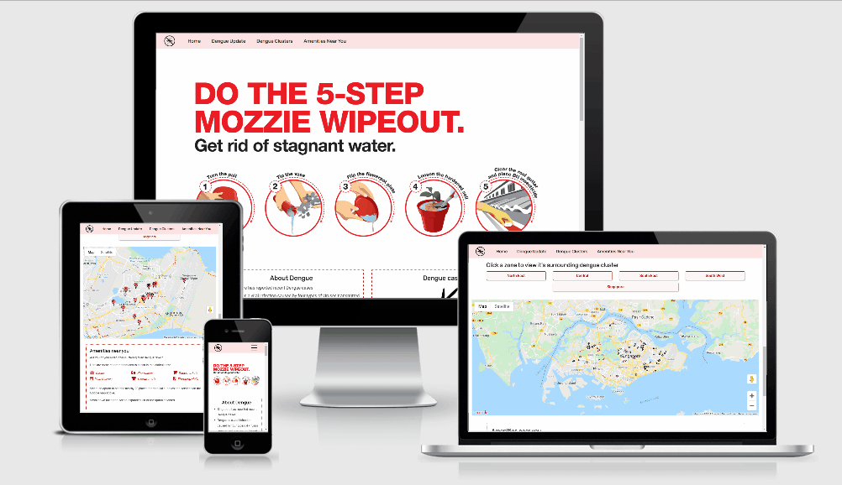
Official (Closed) - Non Sensitive
Displaying your Work Better
Adding in a snapshot or an animated gif of your final product into your README.md
https://www.screentogif.com/
Allows you to capture your screen into an animated gif
How to add screenshot to README.md?
Method 1: HTML
<img src="images/screenshot.png" style="margin: 0;">
Method 2: Using Markdown
![Alt text](relative/path/to/img.jpg)
https://guides.github.com/features/mastering-markdown/#example-images
Example of how your README.md can be visual and descriptive just by using a screencapture gif
Continuing Education & Training (CET)

Slide 52
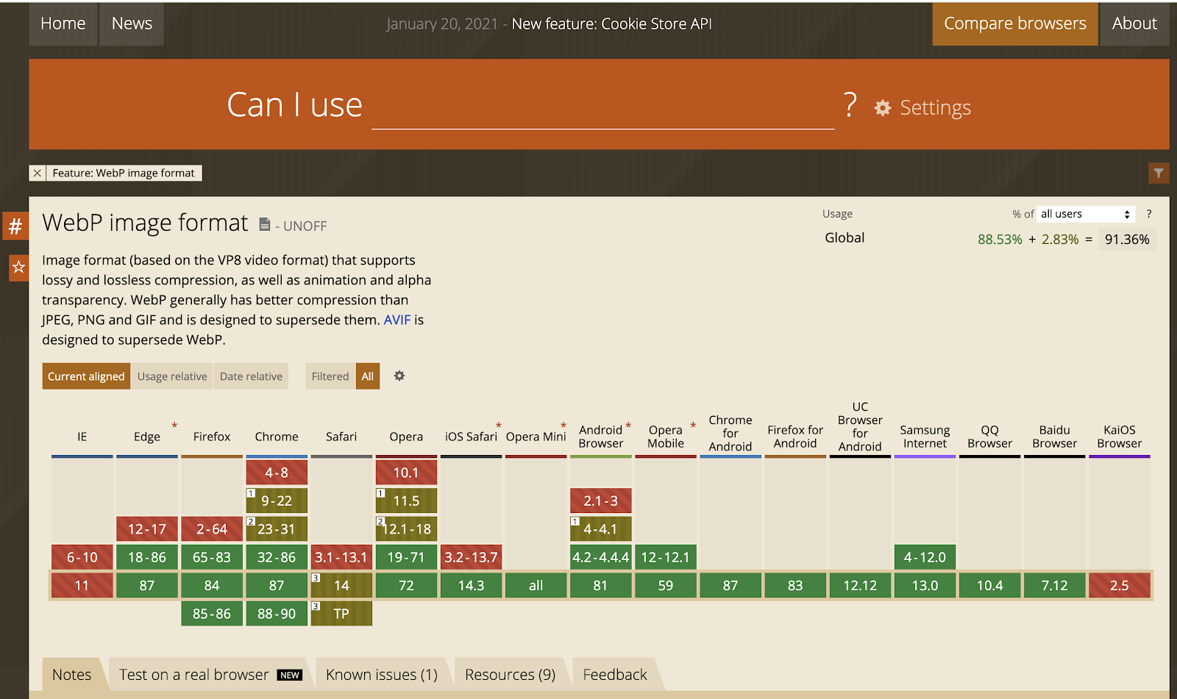
Official (Closed) - Non Sensitive
Checking the latest features
HTML5 has been actively progressing forward, however not all browsers support the latest features.
Check here first >>> https://caniuse.com/
Before using a new HTML API or feature, do check on caniuse.com to ensure that it is properly supported across the browsers you are developing for.
Example query of webp support https://caniuse.com/webp
Support for full webp is almost there!
Continuing Education & Training (CET)

Slide 53
Official (Closed) - Non Sensitive
Cross platform/browser Testing
Tools & Resources
https://www.browserstack.com/cross-browser-testing
https://wptdashboard.appspot.com/
https://crossbrowsertesting.com/
https://www.lambdatest.com/ (Awesome)
http://browsershots.org/ (Great)
Mac user but need to test on Microsoft Edge? How are we going to handle this?
Other than manually installing multiple browsers into our machine, we can automate those tests across browsers and platforms.
Test on different devices, different platforms
Test for responsive design
UI inconsistencies
If you are still testing in Internet Explorer… you are in trouble..
Reading
https://www.sitepoint.com/cross-browser-testing-tools/
https://developer.mozilla.org/en-US/docs/Learn/Tools_and_testing/Cross_browser_testing/Introduction
Continuing Education & Training (CET)

Slide 54
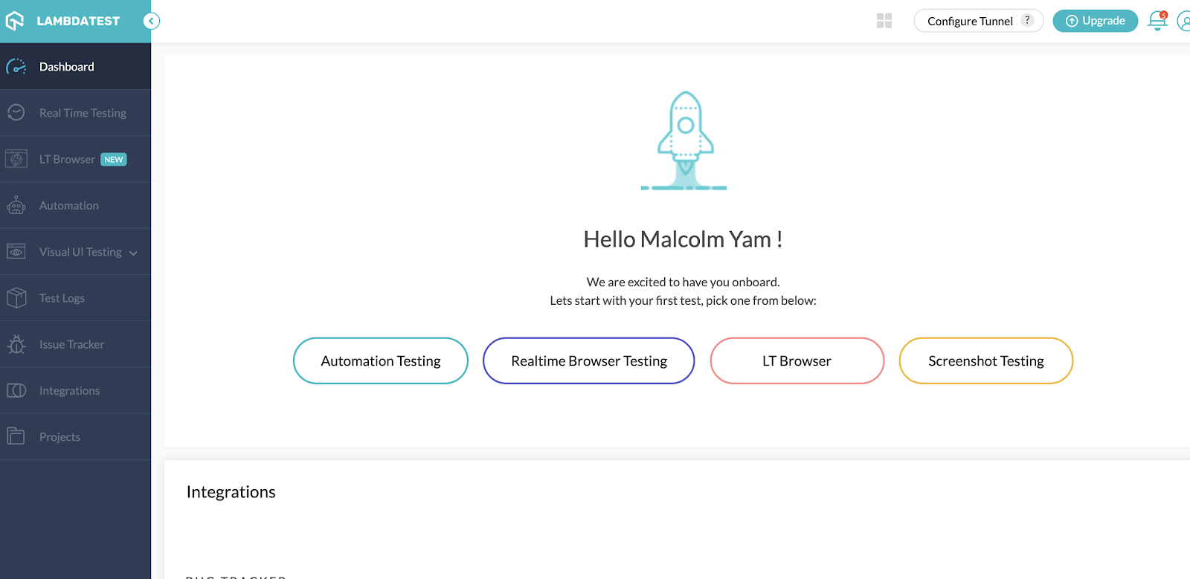
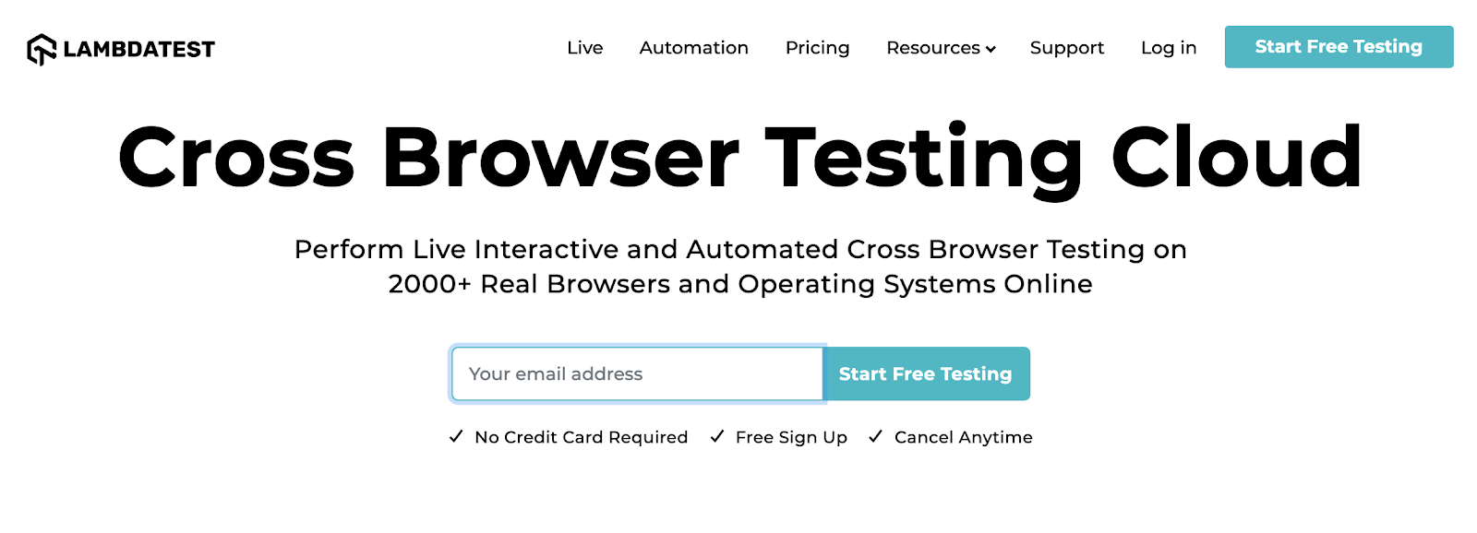
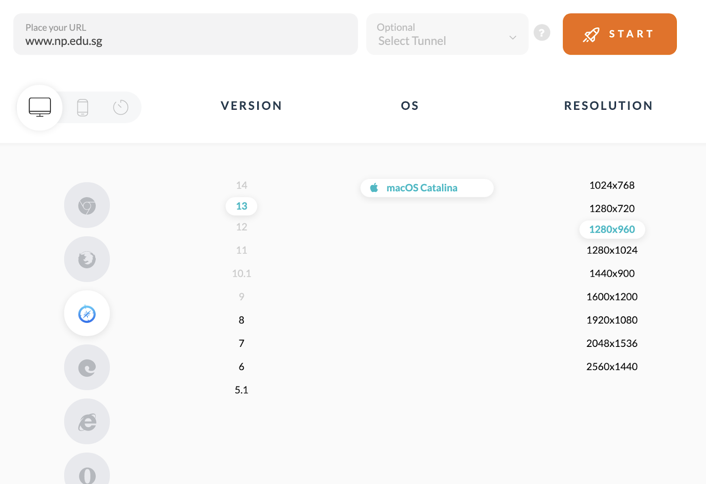
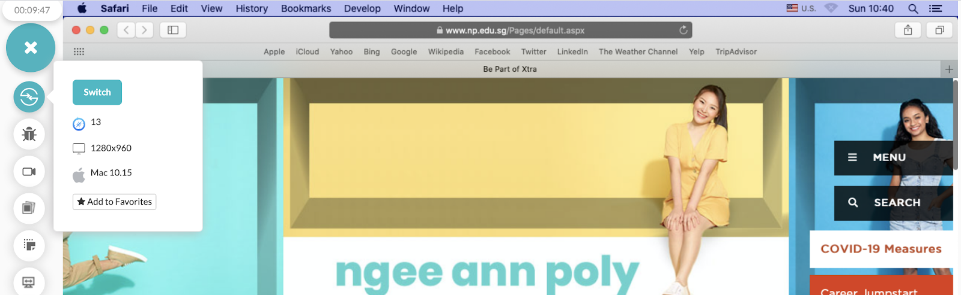
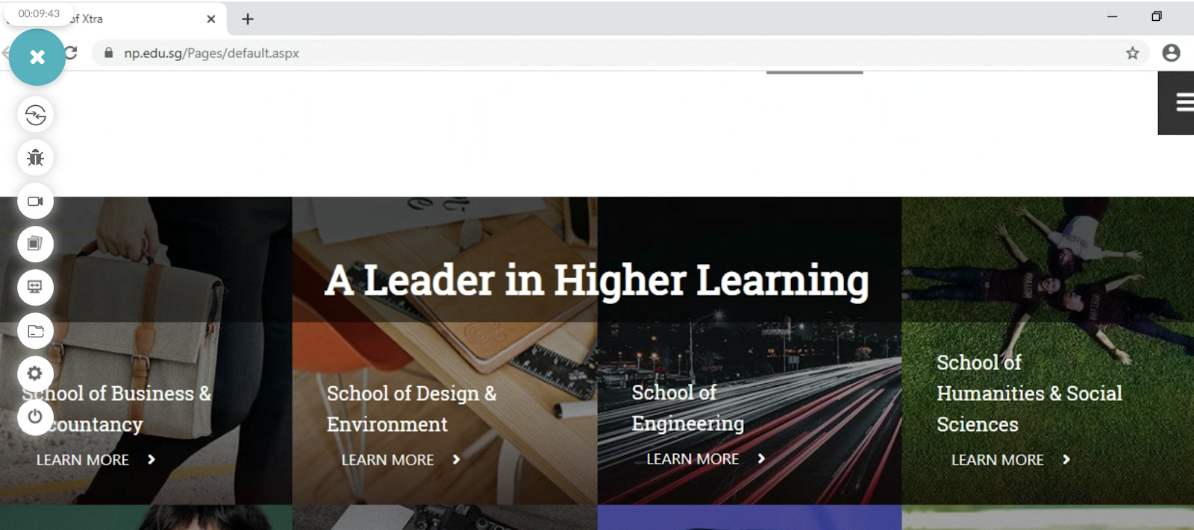
Official (Closed) - Non Sensitive
Cross platform/browser Testing w/ LambdaTest
2
1
Signup for an account
Realtime browser test allows us to run a simulated live testing of a site in platform/os/screen resolution of choice
4
Safari
3
Chrome
The free version is pretty awesome. 10 mins of testing :)
Choose your OS
Choose your screen size
Choose your browser
Continuing Education & Training (CET)

Slide 55
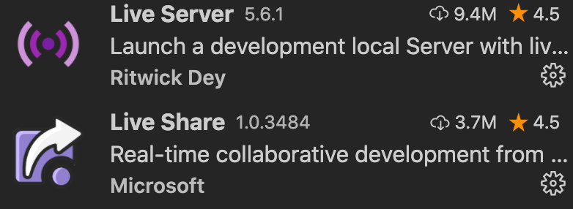



Official (Closed) - Non Sensitive
Decent Code Editor
Tools
https://code.visualstudio.com/ (recommended)
https://github.com/features/codespaces
http://brackets.io/
https://atom.io/
If you are still using repl.it for assignments, it’s time to move on.
If you are using Dreamweaver still, it’s fine if you good in it but it can be a hassle to modify and move your way around code and terrible for collaboration
Great Extensions
Extensions for VS Code. Use with Caution
https://scotch.io/bar-talk/22-best-visual-studio-code-extensions-for-web-development
https://www.syncfusion.com/blogs/post/15-best-visual-studio-code-extensions-for-web-developers.aspx
Continuing Education & Training (CET)

Slide 56
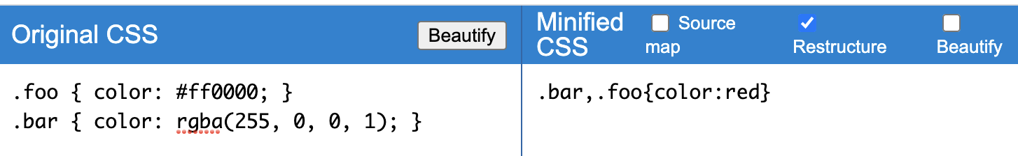
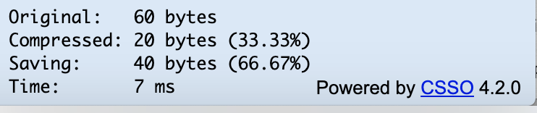
Official (Closed) - Non Sensitive
Code Minifiers
CSS Minifiers
https://cssnano.co/playground/
http://css.github.io/csso/csso.html
JS Minifiers
https://closure-compiler.appspot.com/home
https://www.minifier.org/
https://javascript-minifier.com/
Code minifies helps you to compress code so that it’s lighter and loads faster.
The basic minifiers removes all unnecessary code, removes whitespace, link breaks, comments and so on.
Be sure to backup your original files before minifying. You should ALWAYS have two files, one minified and one unminified.
Use the minified one for production. Most of the tools simply require you to copy your code into their platform. They will generate a minified version for you.
For JS codes, it helps in code obfuscation by making code a little more difficult to read.
Example of CSS minification using CSSO https://css.github.io/csso/csso.html
Continuing Education & Training (CET)

Slide 57
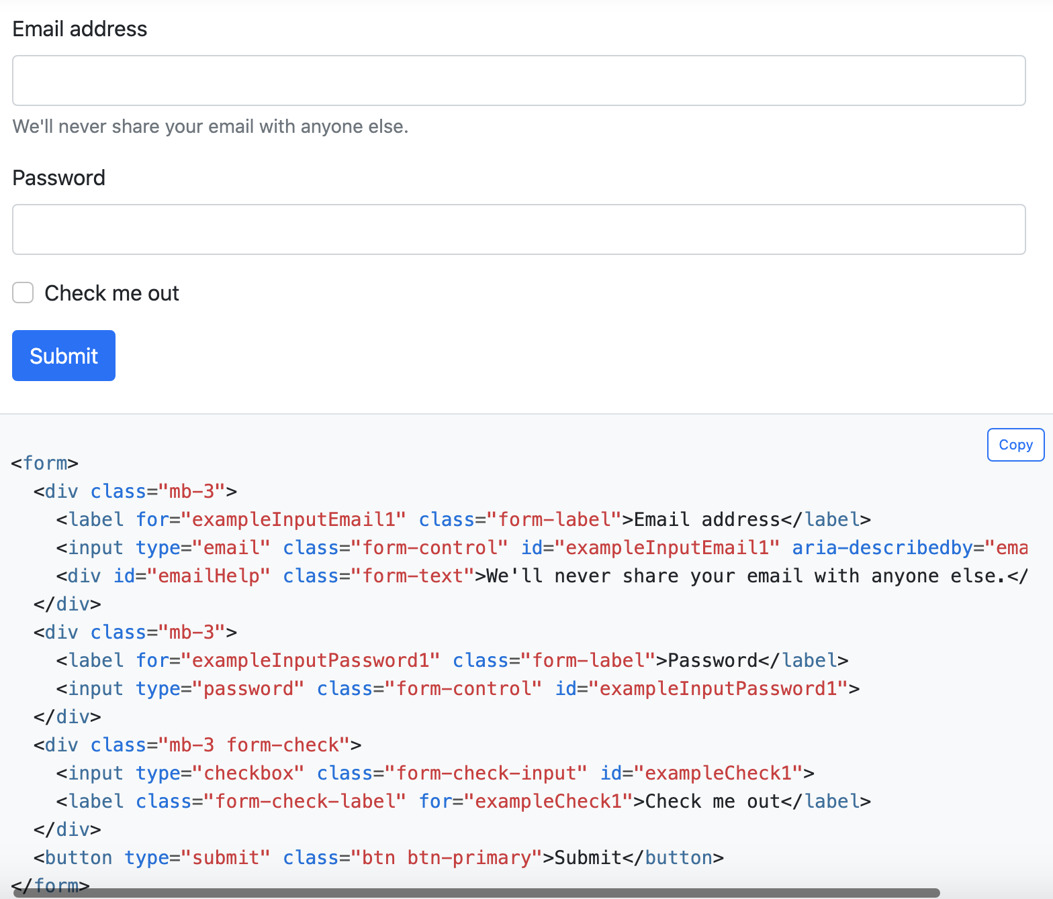
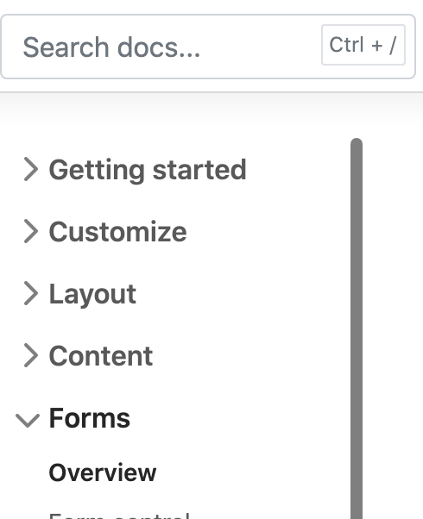
Official (Closed) - Non Sensitive
Step 1: Install
https://getbootstrap.com/docs/5.0/getting-started/introduction/
Step 2: Do responsive layout
Understand their layout system using classes of containers, rows, columns
https://getbootstrap.com/docs/5.0/layout/grid/
Step 3: Doing responsive forms
https://getbootstrap.com/docs/5.0/forms/overview/
BOOTSTRAP
Bootstrap is a wonderful CSS framework for doing responsive designs and layouts. Fast and extremely well-documented, the basic of bootstrap can be easily understood.
Designing responsive forms and tables can also be easily accomplished with bootstrap.
https://getbootstrap.com/
It’s best to start with their documentation samples in their documentation, then move on from there. It is much faster :)
Their examples in the site can be downloaded and modified to your liking. Use their search tool to your advantage when finding sample
Sample responsive form design and code
Continuing Education & Training (CET)

Slide 58
Official (Closed) - Non Sensitive
TRANSITING BETWEEN PAGES (CODE)
You designed multiple pages in your site, but realise your code doesn’t translate or “saved” across the pages. Then you change your design into a single page application..
Or you might have submitted a form but the data is not stored or saved…
Sounds Familiar?
It’s time to use LocalStorage to your advantage.
https://repl.it/@malcolmyam/simple-transition-pages-localstorage
Look at script.js that’s being used in index.html
Then look at another.html’s Javascript code whereby we retrieve the localStorage item.
Continuing Education & Training (CET)

Slide 59
VALIDATION
Official (Closed) - Non Sensitive
Code checking
Continuing Education & Training (CET)

Slide 60
VALIDATION
Official (Closed) - Non Sensitive
Checking out HTML/Website is A-OK
Checks for HTML standards
Learn from best practises
https://validator.nu/
https://observatory.mozilla.org/
http://watson.addy.com/
Checking our CSS is A-OK
https://jigsaw.w3.org/css-validator/
Form Validation
https://developer.mozilla.org/en-US/docs/Learn/Forms/Form_validation
How to in Validate forms in JS: https://www.freecodecamp.org/news/form-validation-with-html5-and-javascript/
https://www.w3schools.com/js/js_validation.asp
Using Library to help
https://formvalidation.io/
Why we validate our code? We want to check that the code is aligning towards the latest standards or “what is right”, help you catch mistakes that you might missed.
Every programming language out there, there’s a certain way to do things proper, certain formatting, certain way of calling things that is standardised.
One of the main reasons for standardisation is….. Anyone can takeover and at least know what is going on.
Reading
https://vanseodesign.com/web-design/validating-code/
Continuing Education & Training (CET)

Slide 61
Official (Closed) - Non Sensitive
AXIOS & HTTP & ISSUES
Key Takeaway?
Work on it
Takes quite a sum of practise to get the hang of using promises in combination with async/await and the different ways of interfacing with an API
ALWAYS read the API documentation.
It’s going to save you a great deal of time

Slide 62
Official (Closed) - Non Sensitive
Understanding JSON
1. JSON starts with curly brace { }
2. There's a key/property in each value
let simpleJSON = {
"key1" : "value1",
}
how we access?
simpleJSON.<key1> --> simpleJSON.key1 (retrieves value1)
3. Sometimes, arrays are embedded inside
{
"key": [
object1,
object2
]
}
In our object we can have our object key/value pairs
Sample Object
{
"studentid" : "T93",
"studentname": "Uncle Roger"
}
{
"studentList": [
{
"studentid" : "T93",
"studentname": "Uncle Roger"
},
{
"studentid" : "U491",
"studentname": "Uncle Phil"
}
]
}
To access object 1 studentid??
studentList[0].studentid --> because it’s the first item in the array. Take note of the square brackets
KEY
Continuing Education & Training (CET)
Notes:
Understanding JSON is important. It is what we deal with in various data formats.
Basically we are always dealing with a key and a value
How do we access it?

Slide 63

Official (Closed) - Non Sensitive
Fetch
Additional
Learn Fetch API in 6 mins https://www.youtube.com/watch?v=cuEtnrL9-H0
Fetch API Introduction
https://www.youtube.com/watch?v=Oive66jrwBs
Fetch API: https://www.youtube.com/watch?v=g6-ZwZmRncs
Continuing Education & Training (CET)
Notes:
Here’s a short recap on what Fetch is. The important thing about fetch is we are improvising how we are handling callbacks.
It is mainly handling our callbacks better through the usage of a promise.
A promise is like waiting for a return call, once the person returns your call then you start speaking to them.
.then() → is a promise waiting for data to process
Learn Fetch API in 6 mins https://www.youtube.com/watch?v=cuEtnrL9-H0
Fetch API Introduction
https://www.youtube.com/watch?v=Oive66jrwBs
Cross-origin resource sharing (CORS) is a browser mechanism which enables controlled access to resources located outside of a given domain.

Slide 64
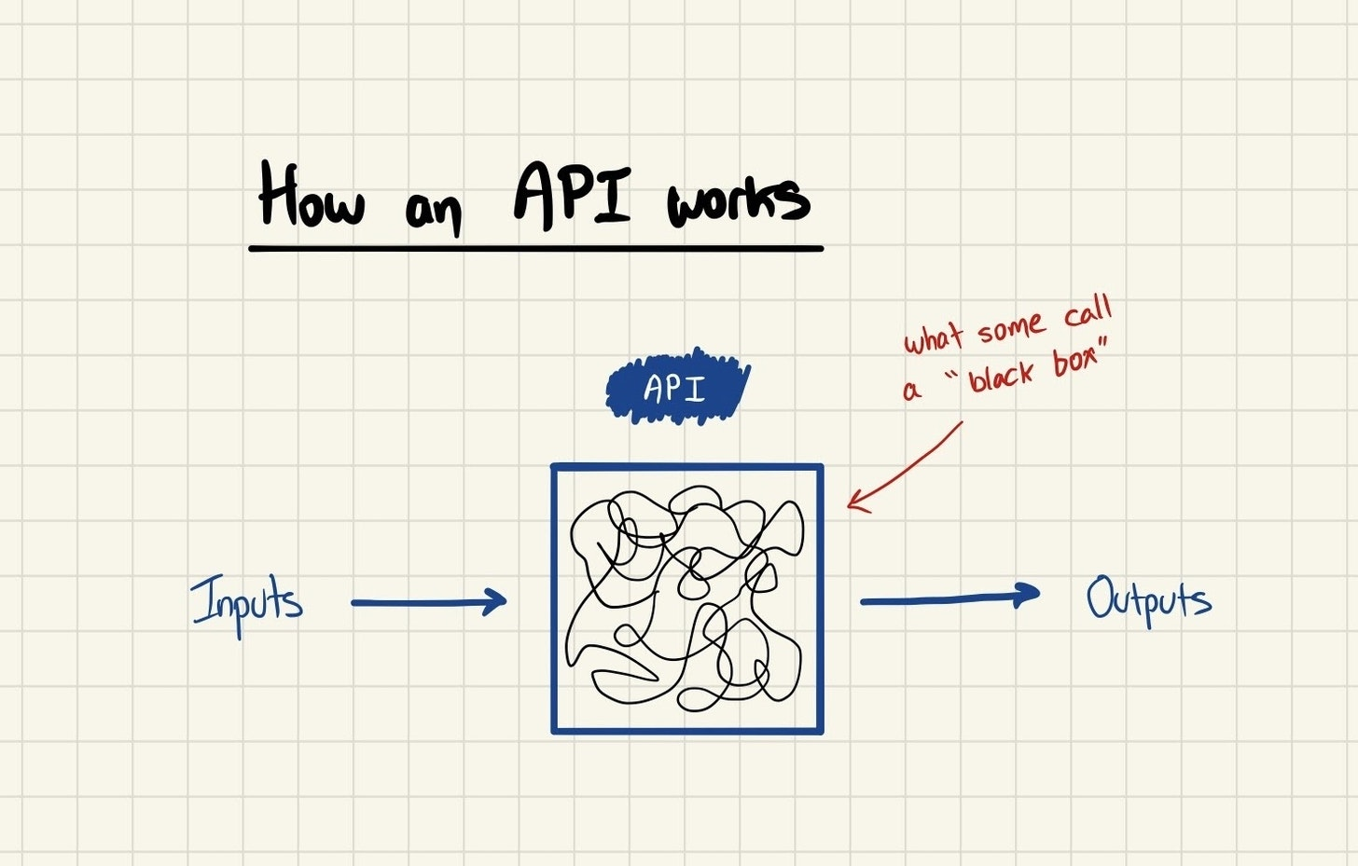
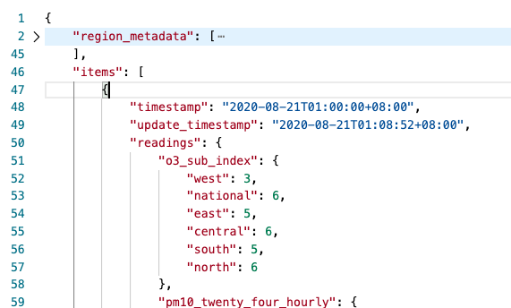
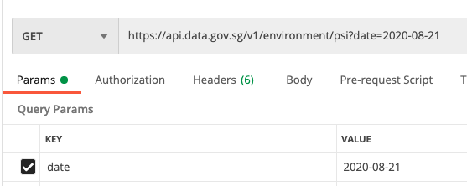

Official (Closed) - Non Sensitive
What is an API
An API is a group of logic that takes a specific input and gives you a specific output.
If you give the Google Maps API an address as an input, it gives you back that addresses lat / long coordinates as an output
If you give the Grab Driver API a start and finish address as an input, it finds the best driver as an output
If you give the PSI API a date and time as an input, it finds the PSI levels for the date time specified
API
Reference: https://technically.substack.com/p/whats-an-api
Continuing Education & Training (CET)
Notes:
Now let’s look back at what an API is.
There are many different APIs out there.
We use Postman just to test whether our API is working well.
It is not the final code or logic that is processed. It is just a tool for us to test.
As like our waiter example last week, API allows us to process our inputs are returns outputs nicely process for you.

Slide 65
Official (Closed) - Non Sensitive
What is an API
Applications are just a bunch of functions that get things done: APIs wrap those functions in easy to use interfaces so you can work with them without being an expert. Let’s start with an example. If you’re an e-commerce company, there are a bunch of things you need to get done internally that power your site:
Show available items and sizes
Create orders
Update an email address
When you give an API a bunch of inputs to get the outputs you want, it’s called calling the API.
Continuing Education & Training (CET)
Notes:
APIs? Simply makes things easier for us by working as an interface between complex logic and requests(inputs)

Slide 66
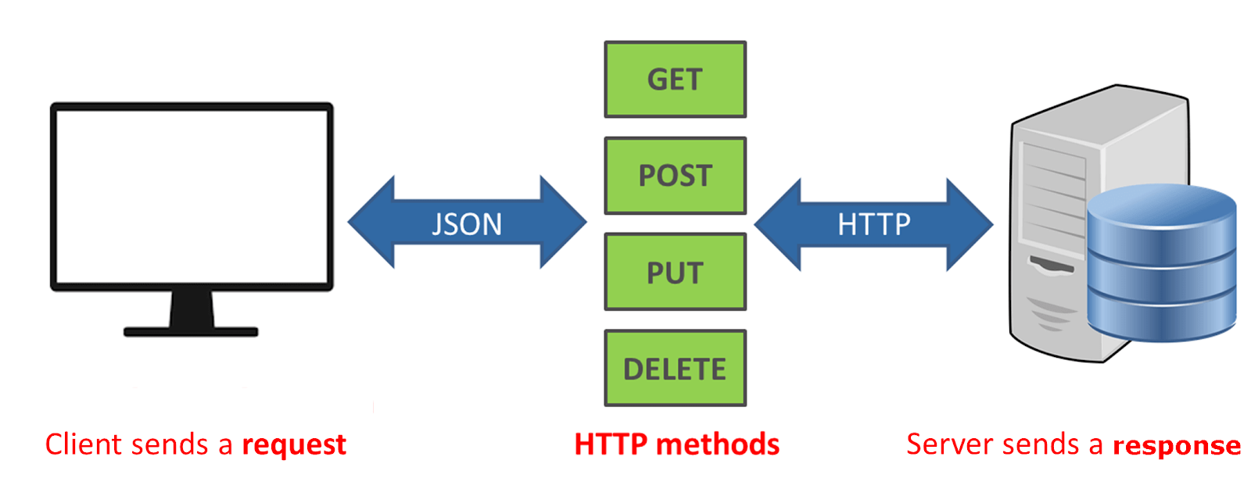
Official (Closed) - Non Sensitive
What is an API
REST APIs work via HTTP, which means you need to use a request-response model: you make a request with a bunch of details, and the server sends back the data you asked for (or a message telling you that something went wrong). Here’s how it breaks down:
https://phpenthusiast.com/blog/what-is-rest-api
Continuing Education & Training (CET)
Notes:
APIs come in different formats but the most commonly used today is in RESTful APIs.
They work via HTTP which is why you can easily test via Postman or using JS to make API calls thorugh HTTP.
There are different HTTP request methods such as GET/POST/PUT/DELETE
GET-> Retrieve Info
POST -> Create new Info
PUT -> Modify Info
DELETE -> Delete info

Slide 67
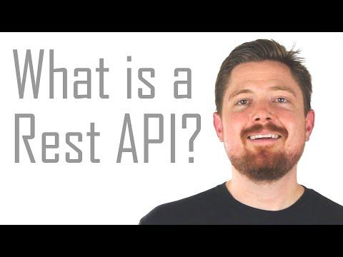
Official (Closed) - Non Sensitive
What is a REST API
Video: https://www.youtube.com/watch?v=7YcW25PHnAA
Continuing Education & Training (CET)
Notes:
Here’s a nice short video on what is a REST API

Slide 68

Official (Closed) - Non Sensitive
More on JSON
Learn JSON in 10 minutes: https://www.youtube.com/watch?v=iiADhChRriM
Continuing Education & Training (CET)
Notes:
https://www.youtube.com/watch?v=iiADhChRriM
Let’s recap again on JSON

Slide 69

Official (Closed) - Non Sensitive
How a request is formed.
3. Headers: The additional details provided for communication between client and server (remember, REST is stateless). Some of the common headers are: Request: - host: the IP of client (or from where request originated) - accept-language: language understandable by the client - user-agent: data about client, operating system and vendor Response: - status: the status of request or HTTP code. - content-type: type of resource sent by server. - set-cookie: sets cookies by server 4. Data: (also called body or message) contains info you want to send to the server.
1. Endpoint: It is the URL where the REST Server is listening. https://ipapi.co/json List IP details https://api.data.gov.sg/v1/environment/psi?date=2020-08-21 - List PSI data on 2020-08-21 2. Method: REST implements multiple 'methods' for different types of request, the following are most popular: - GET: Get resource from the server. - POST: Create resource to the server. - PATCH or PUT: Update existing resource on the server. - DELETE: Delete existing resource from the server.
Continuing Education & Training (CET)
Notes:
4 main parts of how the API request is sent over.
We always start with an endpoint which is the API URl
Then we decide on the method of REST call
Decide on additional requests headers. This is determined by the API. Read the documentation as it will detail the additional headers that are needed. Such as authentication keys, API keys,
There are additional data that comes in the form of request info. This is usually paramaters which modify the request. Such as our PSI date.

Slide 70
Official (Closed) - Non Sensitive
QNS: Why my API works in POSTMAN but cannot work in my code?
Sometimes, APIs companies restrict their API access and also prevent based on authentication, URLs, restrictions, whitelisting etc. Many different ways.
The most common issue is CORS.
Cross origin Resource Sharing mechanism that restricts APIs to be used.
https://www.codecademy.com/articles/what-is-cors
We can bypass this issue to a limited extend by implementing cors-anywhere (this is an external call made by a developer)
https://github.com/Rob--W/cors-anywhere
How we implement it?
We simply add on the cors-anywhere URL to our own API endpoint
Origin endpoint: http://datamall2.mytransport.sg/ltaodataservice/BusArrivalv2?BusStopCode=83139
New Endpoint: https://cors-anywhere.herokuapp.com/http://datamall2.mytransport.sg/ltaodataservice/BusArrivalv2?BusStopCode=83139&=",
https://replit.com/@immalcolm/cors-issue-fix-ltabusapi-test
Do use your own account keys
Signup for LTA API access: https://www.mytransport.sg/content/mytransport/home/dataMall.html
Continuing Education & Training (CET)
Notes:
https://www.bootstrapdash.com/bootstrap-app-landing-page-templates/
https://graygrids.com/bootstrap-app-landing-page-templates/
https://athemes.com/collections/free-bootstrap-admin-templates/
https://adminlte.io/

Slide 71
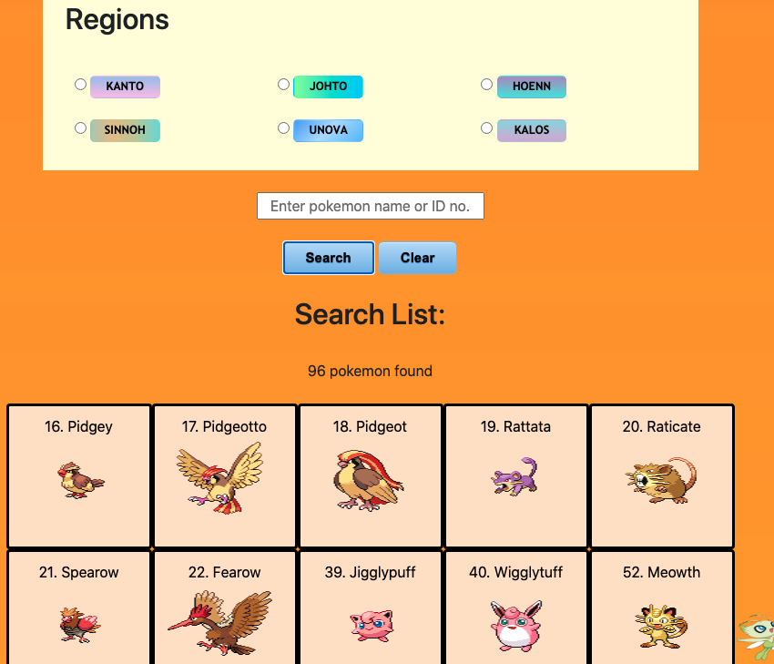

Official (Closed) - Non Sensitive
“Pokedex”
Bootstrap
jQuery
API Used: Pokemon API, localStorage, Google Charts
https://pokeapi.co/
Problem Statement?
Many generations of Pokemon, All in one handler for it
Continuing Education & Training (CET)

Slide 72
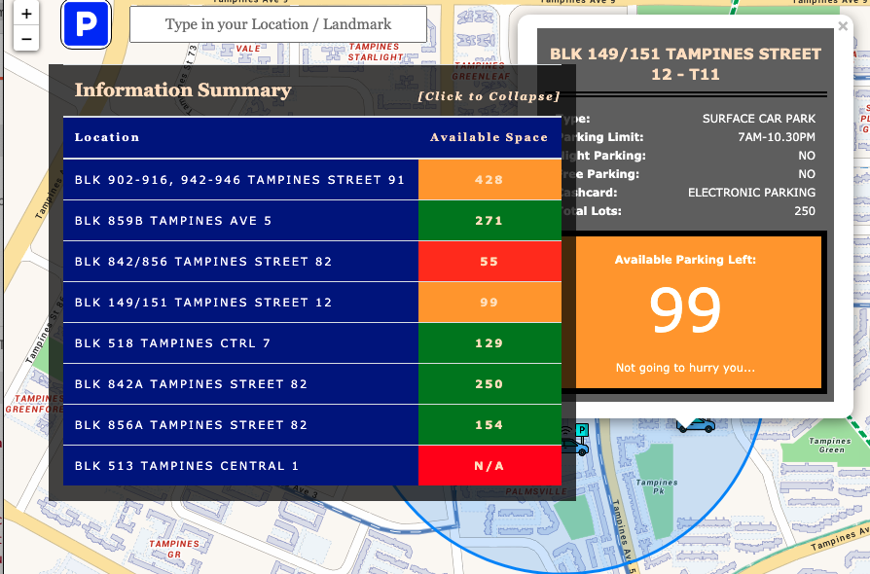
Official (Closed) - Non Sensitive
Parking App Desktop/Mobile
Bootstrap
jQuery
Leaflet JS
API Used: OneMapSG, Data.gov.sg (Carpark Availablity)
https://docs.onemap.sg/
https://data.gov.sg/dataset/carpark-availability
https://www.mapbox.com/
Continuing Education & Training (CET)

Slide 73
Official (Closed) - Non Sensitive
Some Sample APIS
https://any-api.com
https://dev.twitter.com/
http://www.dex.sg/collections/
https://developers.data.gov.sg
https://www.nea.gov.sg/api/
https://github.com/public-apis/public-apis
https://rapidapi.com/collection/list-of-free-apis
https://rapidapi.com/
https://apilist.fun/
https://public-apis.xyz/
https://www.mapbox.com/
https://www.mas.gov.sg/development/fintech/financial-industry-api-register
https://docs.onemap.sg/#onemap-rest-apis
https://github.com/TonnyL/Awesome_APIs
https://dev.to/camerenisonfire/10-intriguing-public-rest-apis-for-your-next-project-2gbd
https://public-apis.io/
http://www.omdbapi.com/
https://the-one-api.dev/
https://www.reddit.com/dev/api/
https://spoonacular.com/food-api
https://nominatim.org/release-docs/develop/api/Search/
https://wger.de/
To create a NoSQL database with RESTful APIs?
https://restdb.io/
ICONS?
https://www.flaticon.com/
https://thenounproject.com/
https://icons8.com/
https://freeicons.io/
https://www.canva.com/learn/free-icons-download/
Charts?
https://www.chartjs.org/
https://repl.it/@malcolmyam/wk0x-simplecharts#index.html
Continuing Education & Training (CET)

